Slide 1
Fiscal Year 2023/24 Financial Update Through December 2023
February 21, 2024

Slide 2
Overview/Reminders
All amounts are preliminary, unaudited and subject to change
Year-end estimates may not include adjusting audit entries required at year-end
Year-end estimates should not be relied upon as precise predictors of year-end balances; they are fluid, informational, and based on currently available data
The Town’s financial performance throughout the fiscal year is best indicated by comparing actuals to the adopted budget
Overall, revenues and expenditures are performing well compared to budget

Slide 3
Highlights
Revenues and expenditures generally performing well compared to budget
Strong growth in state shared revenue from last year (trending with budget)
Local sales tax roughly flat to last fiscal year (budgeted 3% decline)
Restaurant & bar 4.1% growth
Utilities 9.6% growth
Bed tax 6.6% growth
Retail .3% decline
Construction 3.6% decline (budgeted 16.6% decline)

Slide 4
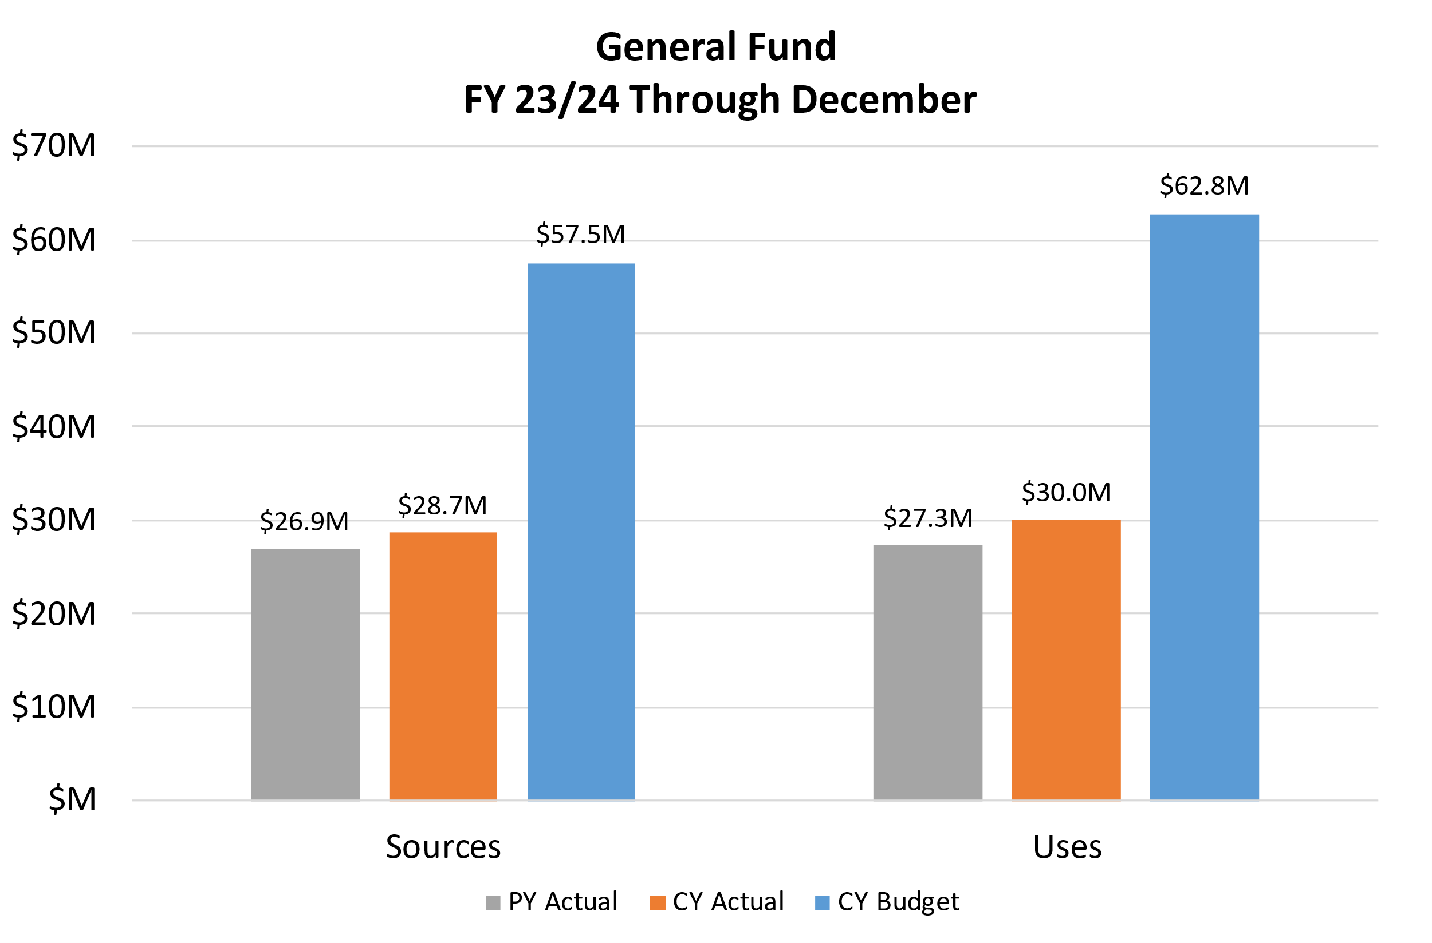
General Fund
Budgeted Use of Fund Balance: ($5.3M)
Estimated Use of Fund Balance: ($3.4M)
Estimated Ending Fund Balance: $20.4M
40.3% of budgeted expenditures
Exceeds Council 30% Policy by $5.2M
Notes:
Sources are up 6.5% over prior year
Uses are up about 9.9% over prior year
Ending fund balance is estimated to be about $1.85 million (10.0%) more than budget

Slide 5
General Fund Revenues – Year to Date
 | FY23 Actuals | FY24 Actuals | Budget | % of Budget | Year-End Estimate
Local Sales Taxes | $ 13,029,974 | $ 13,315,962 | $ 26,398,318 | 50.4% | $ 27,244,813
State Shared Revenues | 9,212,785 | 11,237,689 | 22,953,222 | 49.0% | 22,911,466
Charges for Services | 1,388,841 | 1,510,151 | 3,204,246 | 47.1% | 3,028,885
Licenses & Permits | 1,556,707 | 969,704 | 1,717,118 | 56.5% | 1,828,007
Grant Revenue | 360,915 | 250,465 | 657,415 | 38.1% | 728,886
All Other | 1,356,016 | 1,379,234 | 2,557,500 | 53.9% | 2,885,932
Total | $ 26,905,238 | $ 28,663,205 | $ 57,487,819 | 49.9% | $ 58,627,989
Notes:
Projected favorable budget variance of $1.2 million or 2.0% due to local sales tax, and miscellaneous revenue (AMRRP rebate)
Local Sales Taxes: Construction is a decline from PY, actuals exceeding budget.
State Shared Revenues: Trending as expected
Licenses & Permits: Year-end estimate reflects revised commercial and residential permit revenue
SFR Permits: 77 through December (119 budgeted), 135 projected
Grant Revenue: Year-end estimate reflects additional revenue for Transit, Parks & Recreation and Police grants
Intergovernmental:
Charges for Services: Expected to come in slightly below budget due primarily to suspension of transit fares
Other: Actuals include $258K AMRRP rebate (unbudgeted). Includes other intergovernmental revenue, interest income and miscellaneous revenue.

Slide 6
General Fund Uses – Year to Date
 | FY23 Actuals | FY24 Actuals | Budget | % of Budget | Year-End Estimate
Personnel | $ 14,323,406 | $ 15,878,686 | $ 35,698,399 | 44.5% | $ 35,007,347
Operations & Maintenance | 6,281,231 | 6,468,960 | 13,463,760 | 48.0% | 13,443,775
Capital | 162,922 | 546,013 | 1,342,555 | 40.7% | 1,342,555
Transfers Out | 6,548,965 | 7,136,644 | 12,274,644 | 58.1% | 12,274,644
Total | $ 27,316,524 | $ 30,030,303 | $ 62,779,358 | 47.8% | $ 62,068,321
Notes:
Projected favorable budget variance of $0.7 million or 1.1%
Personnel: Year-end estimate attributable to vacancy savings, position refills and PSPRS contributions.
Operations & Maintenance:
Capital: Budget includes Westward Look improvements, IT needs, and various departmental equipment and capital needs. Westward Look Construction is largely complete with progress being made on final close out items.
Transfers Out: Actuals reflect full budgeted transfer for debt service, and 1/2 of budgeted CIP transfer to Capital fund

Slide 7
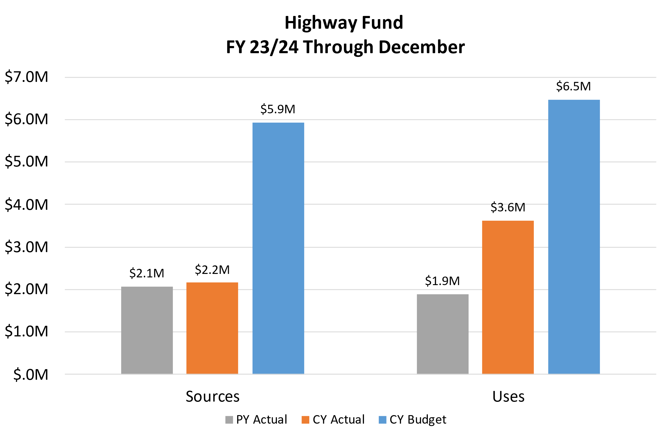
Highway Fund
Budgeted Use of Fund Balance: ($536,183)
Estimated Use of Fund Balance: ($439,990)
Estimated Ending Fund Balance: $438,942
Notes:
Sources are up about 4.4% over prior year
Uses are up about 91% over prior year
Ending fund balance is estimated to be about $96,000 (28%) more than budget

Slide 8
Highway Fund Revenues - Year to Date
 | FY22 Actuals | FY23 Actuals | Budget | % of Budget | Year-End Estimate
State Shared Revenues | $ 2,003,856 | $ 2,051,193 | $ 4,334,608 | 47.3% | $ 4,334,608
Licenses & Permits | 14,334 | 10,710 | 25,000 | 42.8% | 25,000
All Other | 56,540 | 103,656 | 1,573,000 | 6.6% | 1,664,424
Total | $ 2,074,730 | $ 2,165,558 | $ 5,932,608 | 36.5% | $ 6,024,032
Notes:
Projected favorable budget variance of about $91,000 or 1.5% due to interest income and insurance recoveries
Licenses & Permits: Slightly higher than expected.
State Shared Revenues: 95% of revenues in Hwy Fund.
All Other: Favorable budget variance of $910,000 due to interest income and insurance recoveries.

Slide 9
Highway Fund Expenditures – Year to Date
 | FY23 Actuals | FY24 Actuals | Budget | % of Budget | Year-End Estimate
Personnel | $ 539,810 | $ 579,523 | $ 1,262,861 | 45.9% | $ 1,257,857
Operations & Maintenance | 292,643 | 414,529 | 1,003,930 | 41.3% | 1,003,930
Capital | 1,061,921 | 2,628,772 | 4,202,000 | 62.6% | 4,202,000
Total | $ 1,894,374 | $ 3,622,824 | $ 6,468,791 | 56.0% | $ 6,463,787
Notes:
Projected unfavorable budget variance of about ($10,000), or (0.2%) due to O&M
Personnel: As expected, minor savings.
Operations & Maintenance: Greater outside professional services and street maintenance budgeted in CY compared to PY
Capital: Mostly pavement preservation. Higher budget in CY. Also, more road projects in CY:ST013 - First Ave. Mill & Overlay, ST014 - La Cañada Dr/Tangerine Rd Mill/Over

Slide 10
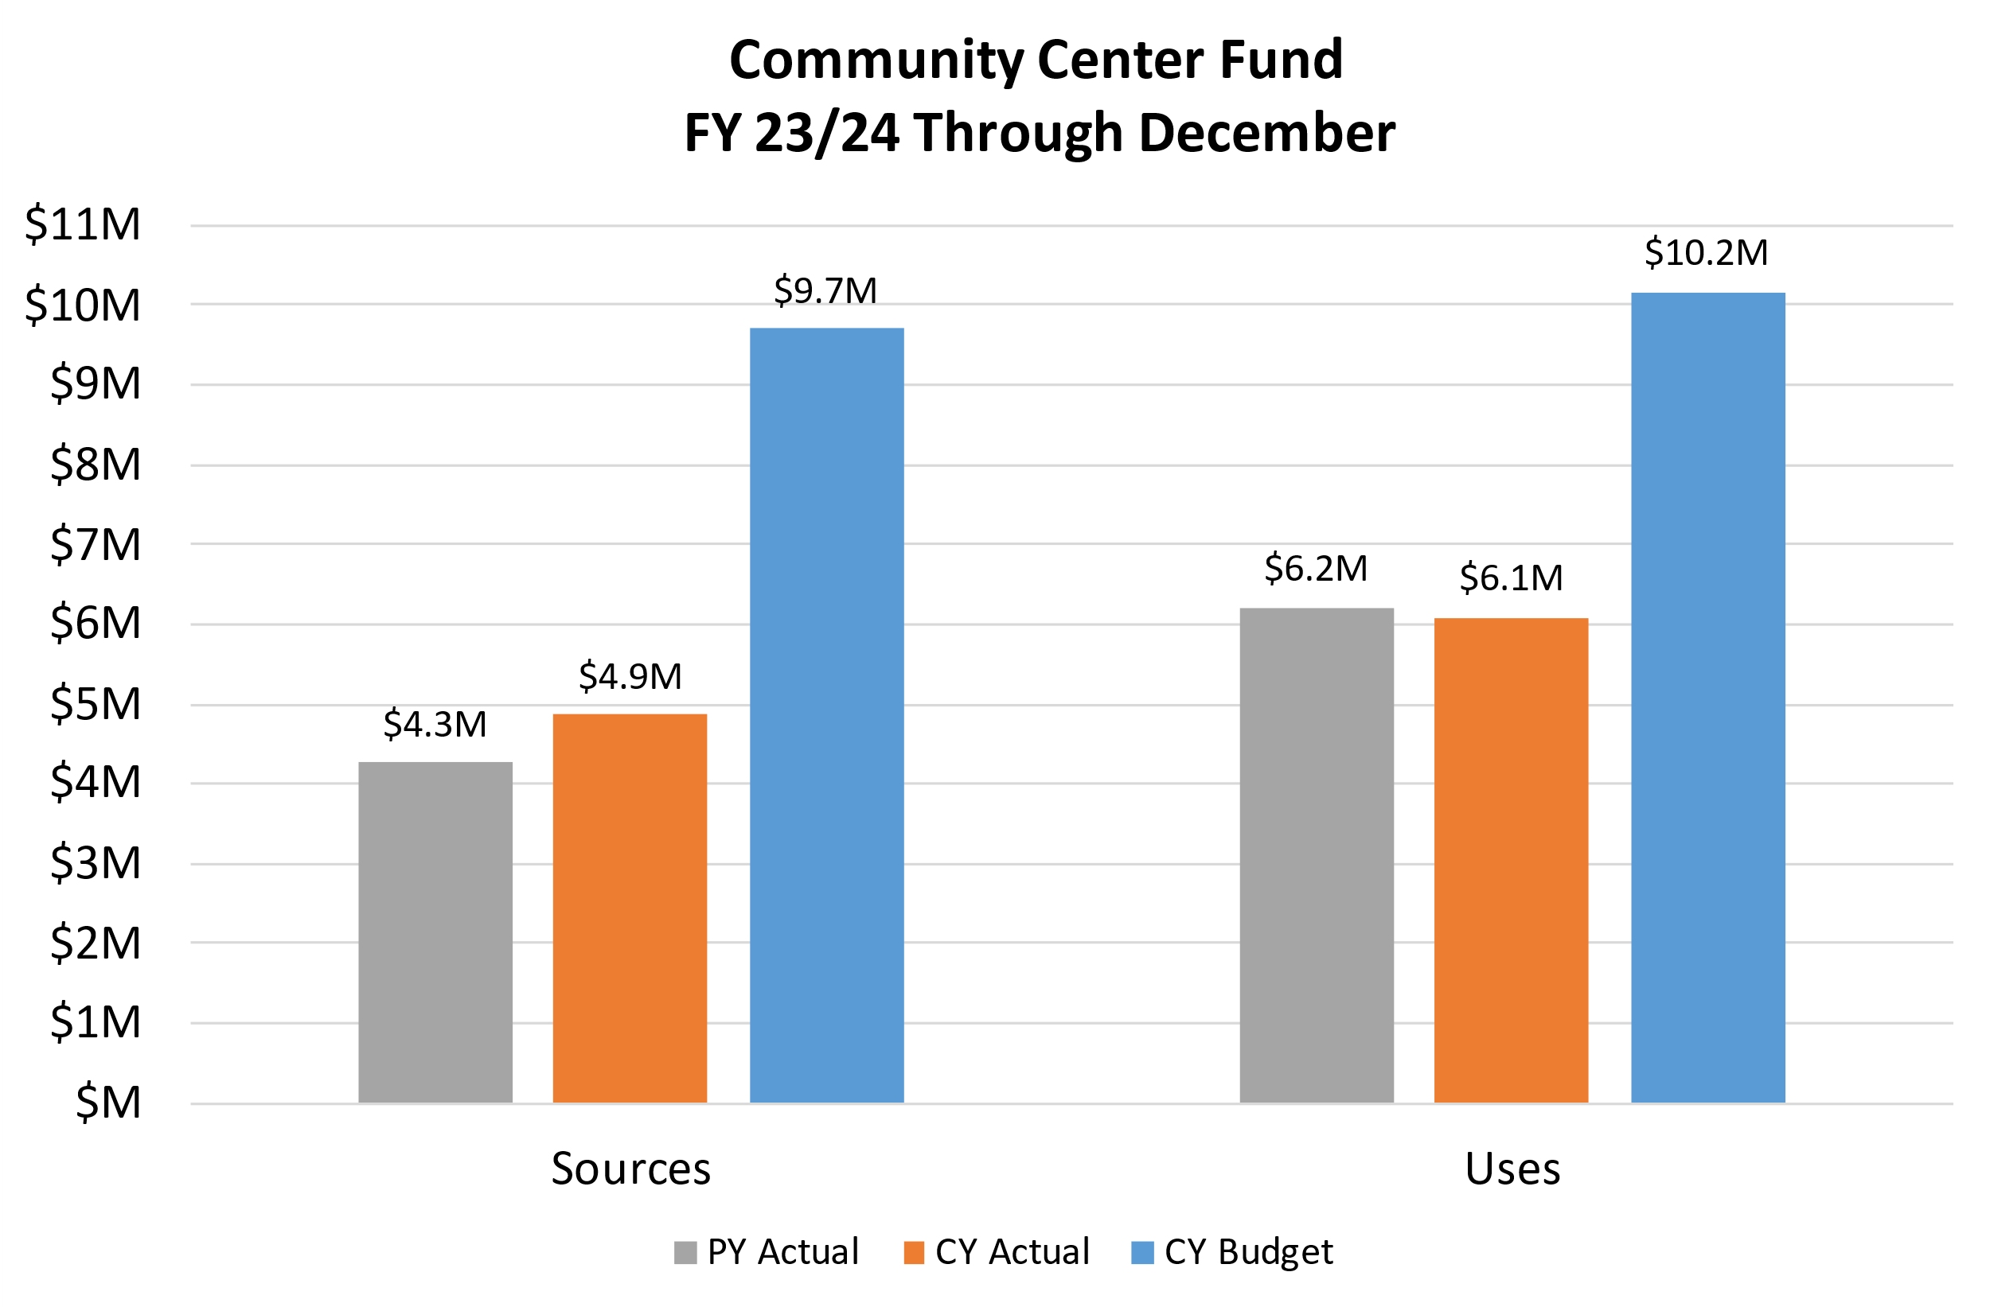
Community Center Fund
Budgeted Use of Fund Balance: ($449,233)
Estimated Increase of Fund Balance: $5,052
Estimated Ending Fund Balance: $1,013,285
Notes:
Sources are up 14.3% over prior year
Uses are up down 2.0% over prior year (expenditures up 4.5% over prior year)
Ending fund balance is estimated to be about $1 million, which is $454,000 or 81% greater than budget

Slide 11
Community Center Fund Revenues –Year to Date
 | FY23 Actuals | FY24 Actuals | Budget | % of Budget | Year-End Estimate
Local Sales Tax | $ 1,720,677 | $ 1,785,176 | $ 3,726,016 | 47.9% | $ 3,786,076
Contracted Operating Revenues | 2,045,645 | 2,461,549 | 4,609,486 | 53.4% | 5,183,890
Town Operating Revenues | 465,905 | 594,181 | 1,175,800 | 50.5% | 1,397,012
Other Revenues | 27,130 | 26,358 | 197,150 | 13.4% | 221,168
Total | $ 4,259,358 | $ 4,867,264 | $ 9,708,452 | 50.1% | $ 10,588,146
Notes:
Projected favorable budget variance of $880,000 or 9.1% due to strong golf revenue, recreation programs, and sales tax revenue
Local Sales Tax: projected to come in $60,000 or 1.6% above budget, due to positive trends in the remote seller category.
Contracted Operating Revenues: Estimated to come in $574,000 or 12.5% over budget mostly due to member dues and greens fees.
Town Operating Revenues: Expected to end the fiscal year about $221,000 higher than budget due mainly to member dues. Recreation programs, daily drop-ins and facility rental income are also expected to exceed budget expectations.
Other Revenues: consists of mostly HOA contributions and interest earnings. Estimated to come in 12% greater than budget due to interest earnings.

Slide 12
Community Center Fund Uses –Year to Date
 | FY23 Actuals | FY24 Actuals | Budget | % of Budget | Year-End Estimate
Contracted Operating Expenditures | $ 2,417,060 | $ 2,796,347 | $ 4,965,264 | 56.3% | $ 5,279,587
Town Operating Expenditures | 778,607 | 828,303 | 1,654,718 | 50.1% | 1,726,983
Capital Outlay | 980,418 | 738,224 | 1,820,500 | 40.6% | 1,859,322
Transfers Out | 2,028,066 | 1,717,203 | 1,717,203 | 100.0% | 1,717,203
Total | $ 6,204,152 | $ 6,080,076 | $ 10,157,685 | 59.9% | $ 10,583,095
Notes:
Projected budget variance of ($425,000) or (4.2%) due to contracted golf operations
Contracted Operating Expenditures: Estimated to come in 6.3% over budget due to greater than expected utilities and labor costs, as well as cost of sales.
Town Operating Expenditures: Estimated to come in ~$72,000 over budget due to trending of personnel costs, as well as contracted program instructors.
Capital Outlay is estimated to come in approximately $39,000 over budget due primarily to equipment costs
Transfers Out: expected to end the year on budget

Slide 13
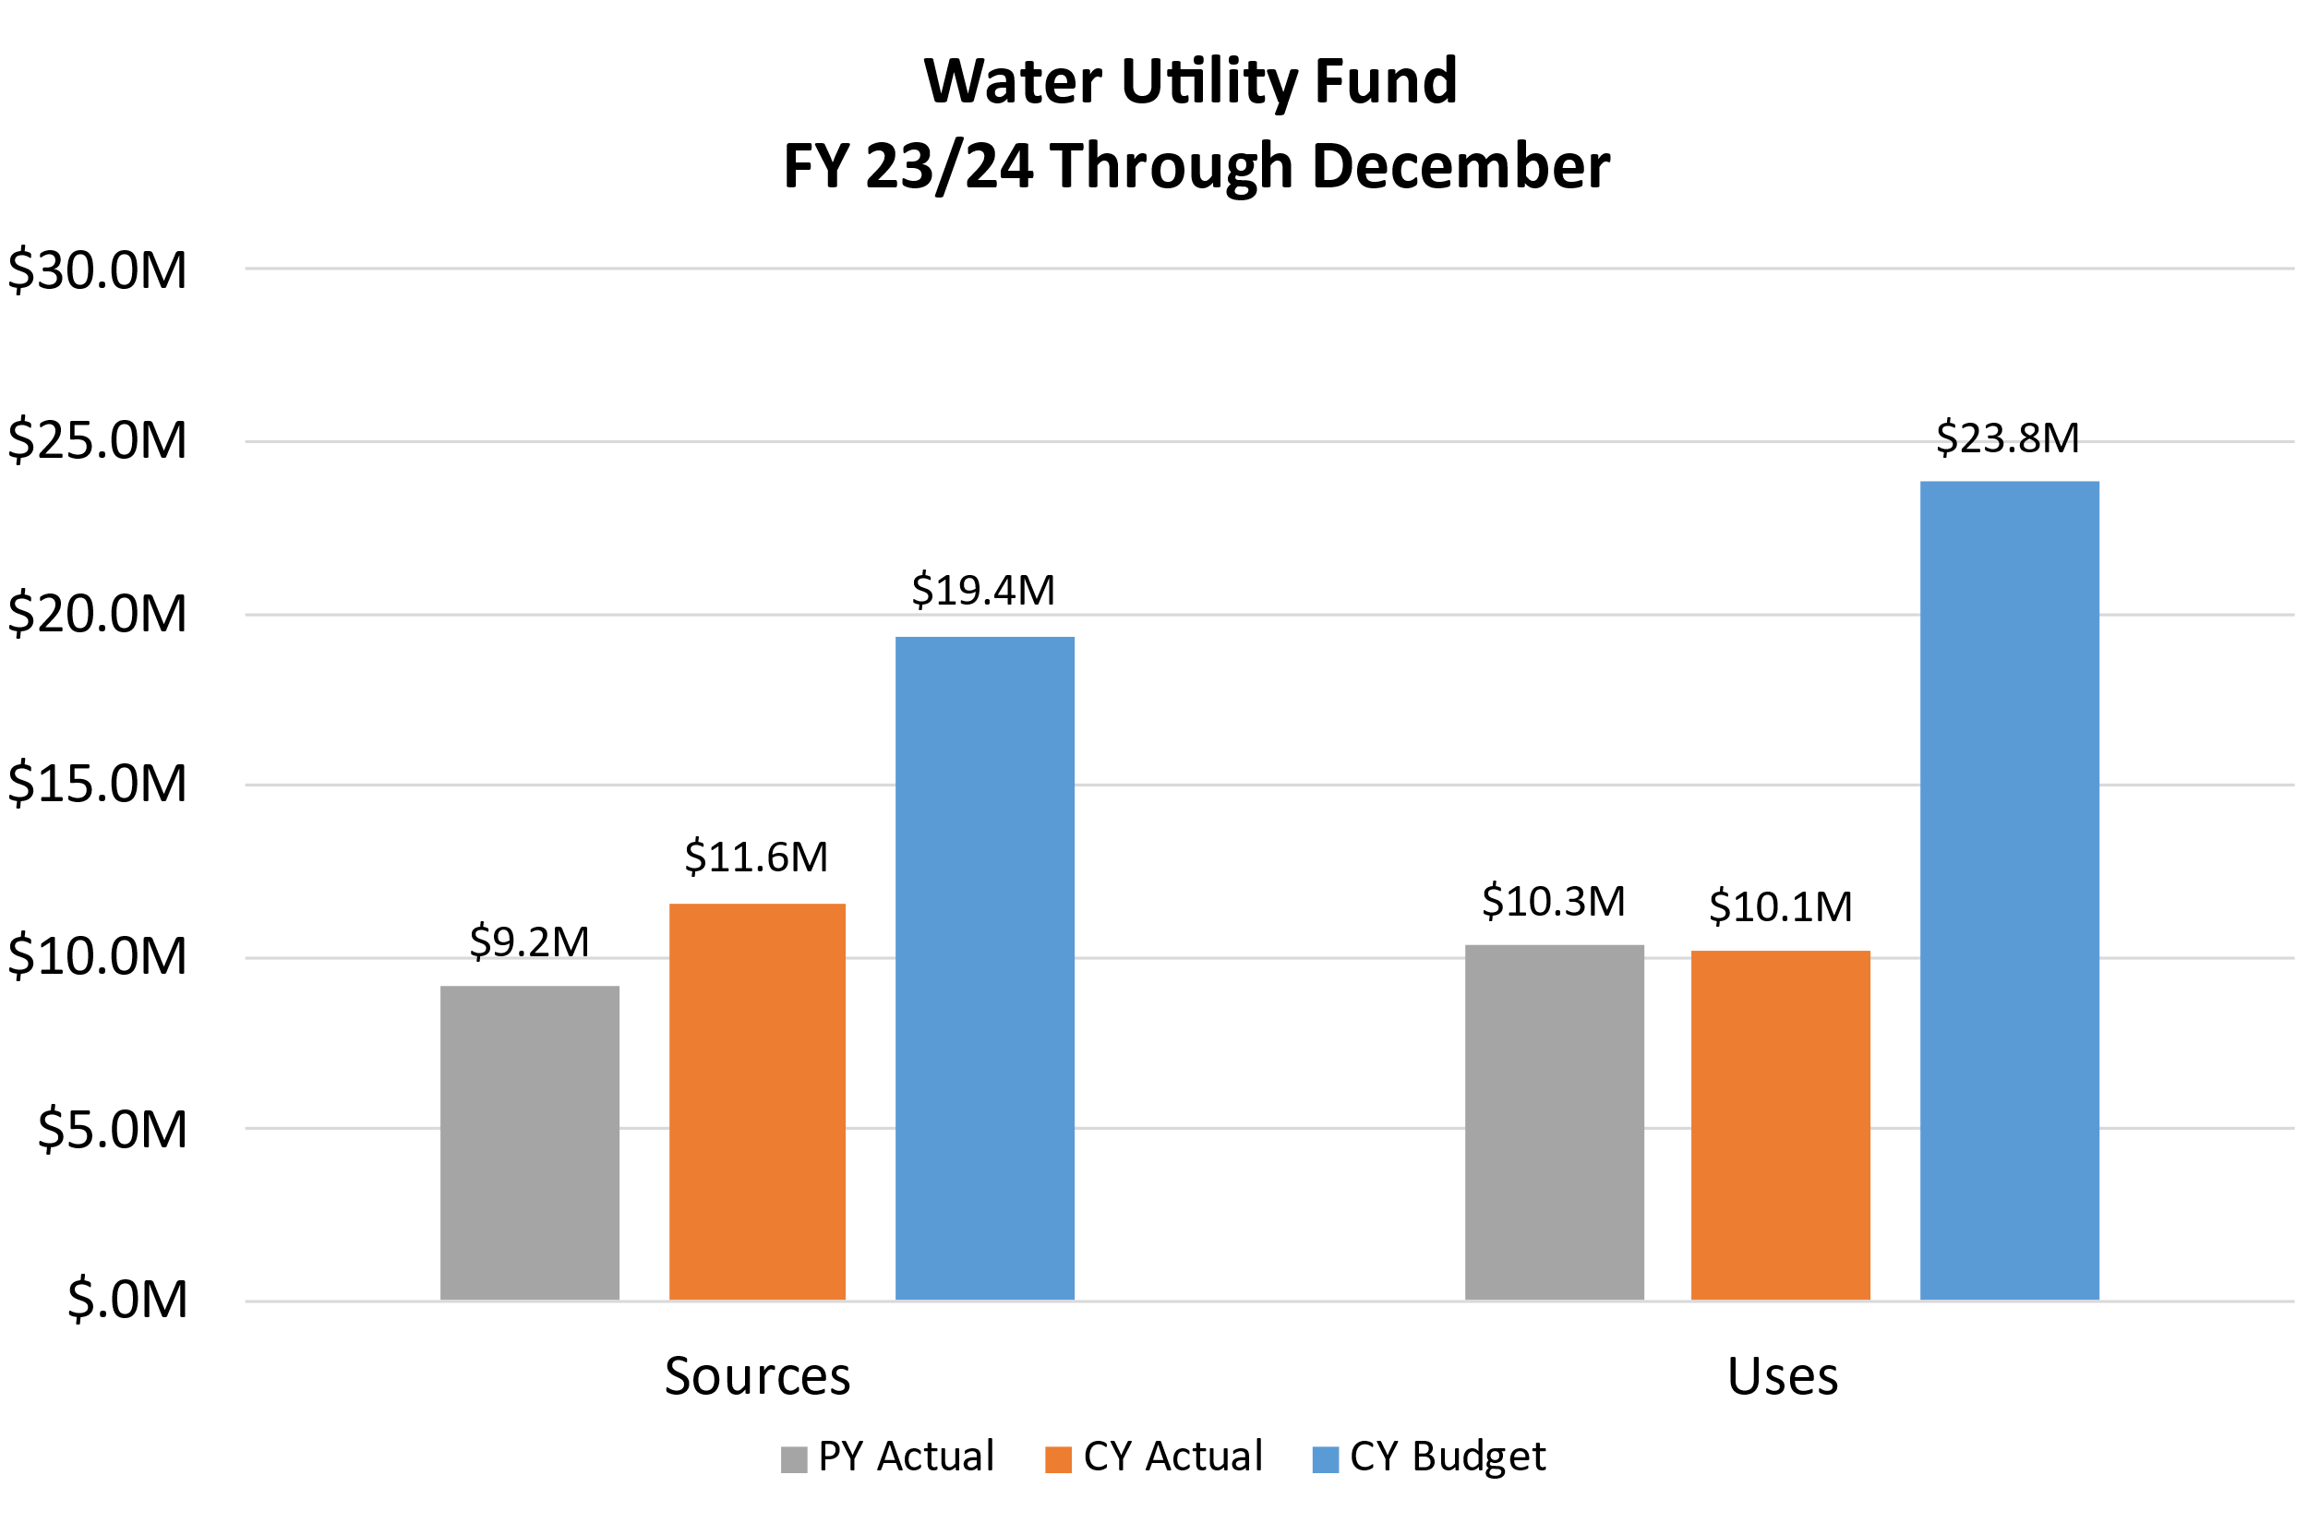
Water Fund
Budgeted Use of Fund Balance: ($4,453,642)
Estimated Use of Fund Balance: ($3,478,726)
Estimated Ending Fund Balance: $8,815,046
Notes:
Sources are up 26.4% over prior year (revenues up 20.7%)
Uses are down 1.9% over prior year (expenditures down 1.9% over prior year)
Ending fund balance is estimated to be $8.8 million which is $975,000 or 12.4% greater than budgeted

Slide 14
Water Fund Revenues – Year to Date
 | FY23 Actuals | FY24 Actuals | Budget | % of Budget | Year-End Estimate
Water Sale | $ 7,573,941 | $ 9,366,844 | $ 16,060,000 | 58.3% | $ 16,000,000
Charges for Services | 1,476,168 | 1,522,893 | 3,200,500 | 47.6% | 3,252,583
Interest Earnings | 55,327 | 139,673 | 100,000 | 139.7% | 170,000
Miscellaneous | 46,393 | 13,214 | - | NA | 25,314
Transfers In | - | 522,701 | - | NA | 522,701
Total | $ 9,151,829 | $ 11,565,326 | $ 19,360,500 | 59.7% | $ 19,970,598
Notes:
Water sales trending slightly below budget at 58.3%, or $9.4 million through December
Because of lower trending water sales and charges, this revenue source is anticipated to end the fiscal year 0.4% or $60,000 below budgeted levels. This is due to more rain than expected, resulting in less water usage.
Charges for service revenues are trending below budget 47.6%, or $1.5 million through December. Charges for Services account for revenues from various fees including the groundwater preservation fee.
$0.5 million of ARPA was transferred into the Water Utility Fund from the Grants Fund to fund water infrastructure projects.

Slide 15
Water Fund Uses – Year to Date
 | FY23 Actuals | FY24 Actuals | Budget | % of Budget | Year-End Estimate
Personnel | $ 1,609,028 | $ 1,679,815 | $ 3,870,809 | 43.4% | $ 3,682,783
O&M | 4,327,468 | 4,558,080 | 11,176,793 | 40.8% | 11,000,000
Capital Outlays | 177,956 | 608,748 | 2,239,792 | 27.2% | 2,239,792
Debt Service | 4,229,099 | 3,300,830 | 3,644,440 | 90.6% | 3,644,440
Transfers Out | 2,440 | 2,308 | 2,882,308 | 0.1% | 2,882,308
Total | $ 10,345,992 | $ 10,149,781 | $ 23,814,142 | 42.6% | $ 23,449,323
Notes:
Uses for the Water Fund are trending as expected through December, totaling $10.1 million, or 42.6% of budget.
Anticipated to end the year 1.5% or $365,000 below budget from various savings in personnel and O&M
Scheduled transfers out will take place later in the fiscal year.

Slide 16
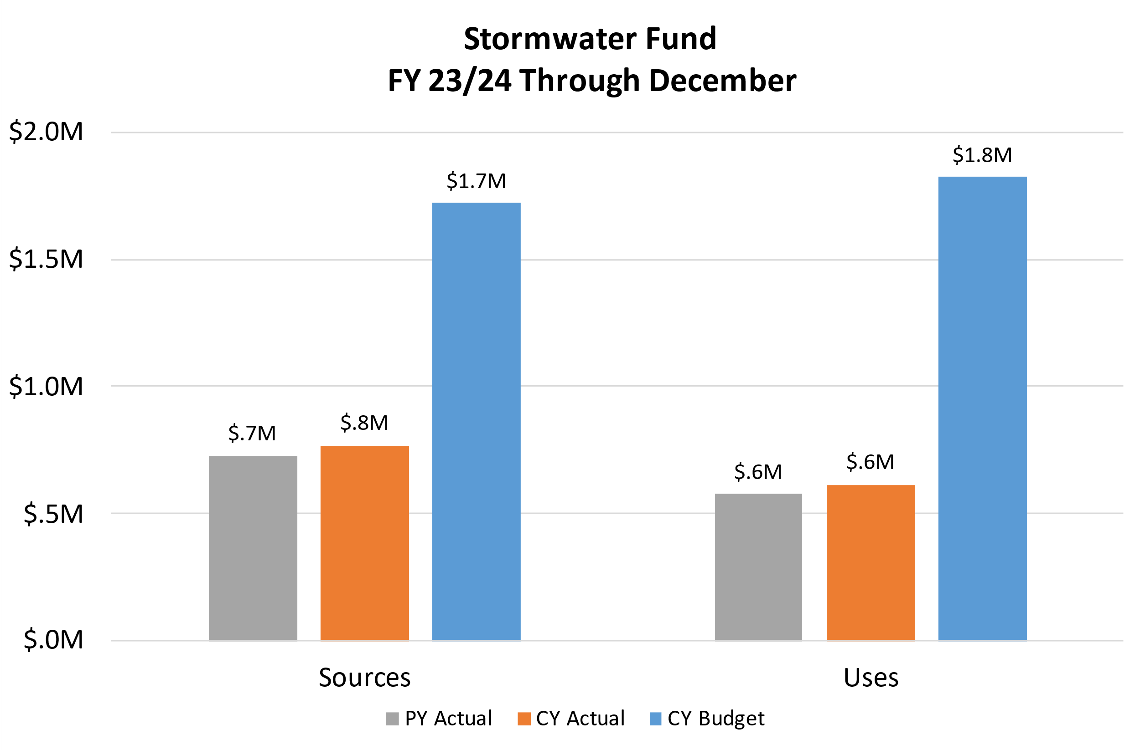
Stormwater Fund
Budgeted Use of Fund Balance: ($100,961)
Estimated Use of Fund Balance: ($75,487)
Estimated Ending Fund Balance: $847,625
Notes:
Revenues are up 5.8% over prior year
Expenses are up 2.8% over prior year
Ending fund balance is estimated to be $847,625 which is ~$25,000 or 3.1% greater than budgeted

Slide 17
Stormwater Fund Revenues – Year to Date
 | FY23 Actuals | FY24 Actuals | Budget | % of Budget | Year-End Estimate
Federal Grants | $ - | $ - | $ 210,000 | 0.0% | $ 210,000
Charges For Services | 720,747 | 758,109 | 1,501,500 | 50.5% | 1,520,839
Interest Earnings | 6,643 | 11,389 | 10,000 | 113.9% | 20,389
Total | $ 727,390 | $ 769,498 | $ 1,721,500 | 44.7% | $ 1,751,229
Notes:
Revenues for the Stormwater Fund are trending lower than expected through December. This is due to budgeted federal grant revenue pending award for the Sierra Wash project. Charges for Services represent the bulk of revenue for the Stormwater Fund and are currently trending slightly above budget at $758,000 or 50%. Overall revenues in the fund are anticipated to end the fiscal year $30,000, or 1.7% above budget.

Slide 18
Stormwater Fund Uses – Year to Date
 | FY23 Actuals | FY24 Actuals | Budget | % of Budget | Year-End Estimate
Personnel | $ 389,365 | $ 432,734 | $ 947,302 | 45.7% | $ 951,557
O&M | 163,924 | 130,594 | 369,159 | 35.4% | 369,159
Capital Outlay | 22,820 | 50,700 | 506,000 | 10.0% | 506,000
Total | $ 576,109 | $ 614,028 | $ 1,822,461 | 33.7% | $ 1,826,716
Notes:
Stormwater expenses are trending below budget but are anticipated to increase as maintenance and projects increase in the second half of the fiscal year. Expenses are anticipated to end the fiscal year slightly over budget by $4,000, or 0.2% due to personnel expenses.

